Slide 1
Develop Mechanics
Mack 2023

Slide 2
Learning Objectives
New mechanics can be created by drawing on the thematic and prior knowledge of the setting.
Idea spiraling is a technique to create new goals and mechanics from previously created goals and mechanics.
Backtracking is a method to create new ideas based off of the same goal or idea.

Slide 3
Brainstorm Mechanics
By the end of this lesson, students will have developed their game premise to the point that it can be paper prototyped. They will have a rough idea of what mechanics they require and are hopefully excited to start testing their game.
In this lesson, students will develop the following game components and the mechanics associated with them in the same groups:
Setting
Player
Goal
Opposition
As a group, students will be documenting various “iteration paths” on a large sheet of paper.
Students will be making 2 sets of game mechanics that can be prototyped. (3 for advanced students)

Slide 4
Review: What are Mechanics?
What players call rules, designers call mechanics. Mechanics are the actions, behaviors and mechanisms that a designer uses to produce gameplay.
Mechanics govern “things that the player can and cannot do.”

Slide 5
Where are we going with this?
Students that we will be taking the game premise and developing enough detail that this game could be paper prototyped.
We will be using the plastic bag game as our example for this exercise, as it is an odd premise. This is to illustrate the idea that you can make a decent game out of any game premise.

Slide 6
Plastic Bag Game Premise
Elevator Pitch: You play as a group of empty plastic bags [player] that want to get put in a garbage can [goal], but you can’t find one [opposition].
Title: Home!
Game Feeling: Triumph, whimsical, collaboration.
Types of Fun: Discovery and Fellowship.
Goal: Reach the garbage can.
Opposition: Winds, society, and no trash cans.
Theme: Big city.

Slide 7
Setting
You should decide on a “physical setting” (or lack of one) for their game.
There are many different representations for a physical setting in a game. Students should try to piggyback on what they know about this setting.
For example, a bank might be a set of safes represented by cards, or a city might be split into sets of areas with roads on a game board. A game set in space or based on the stock market may not even have a physical setting.

Slide 8
For Our Example
A game board made of square or hexagonal tiles.
It could have areas of interest within the game board.
The outside tiles of the game board might be special.
The tiles themselves could have different properties (E.g., red tiles, blue tiles).
The game board might expand/contract over time.
What other spins could we put on a game board representation?
A path based game board.
A game board made out of random cards that get drawn from a deck.
Example Setting: Let’s use a game board of hexagonal tiles for our example.

Slide 9
For Our Example
Objective: You should then think about how the player interacts with the game.
Perhaps players get to control a character that they move around.
They could move their piece around by playing cards with movement values on them (E.g., move 2 spaces).
Their piece could freely move around on their turn.
You might roll dice to move your piece around.
Pieces may just move automatically each turn.
They could move up to 3 spaces per turn.

Slide 10
For Our Example
Alternatively, they might not have a playable character, but instead accumulate currency, victory points, resources or just build up to a goal that results in them winning the game.
Players might draft cards from a shared pool.
They might accumulate victory points for meeting certain criteria (E.g., get 3 of a kind).
Students also need to decide whether the game is cooperative or whether individuals can win. Maybe the game has teams.
Example Player: For our plastic bag example, we will use a token to represent our playable character.

Slide 11
For Our Example
Students should think about the “mechanical representation” of the goal in this step.
Using what we know about the player and setting from the previous steps, we want to create a “mechanical representation” of the goal (how players win).
The “mechanical representation” of the goal can be anything from:
Players win when all other players are eliminated.
Players win when they have eliminated 3 players.
Players win when they all reach a certain tile.
Players win when they get to 50 points.
Players win when they complete the team objective.

Slide 12
For Our Example
We don’t need to know anything about how players are eliminated, how they move around, or how they get points (this comes in the opposition step), but picking a goal and developing the premise around it will allow us to get a playable game that we can then start iterating and building upon.
Example Goal: Let’s use a specific tile on the map to represent the trash can. Players need to get to the trash can to win.
We have 4 players, each with a playable character that needs to make it to the goal tile. The game currently is quite easy and not very compelling or interesting. There’s nothing stopping players from just moving straight to the goal; it lacks opposition.

Slide 13
For Our Example
Objective: You will develop the mechanics of several different types of opposition for their game.
As discussed in some lessons ago, there are typically many ways to solve a problem, each with their own tradeoffs. In this section, students will need to get creative with brainstorming mechanical solutions for the problems they encounter.
At this point, students have their premise, setting (game board), player (player token), and goal (get to the trash can tile).

Slide 14
Creating New Mechanics
Coming up with a new game mechanic is difficult.
They can draw on their theme and game premise to create new mechanics.
Students should draw inspiration from what they know about the theme and what objects or ideas would be associated with it.

Slide 15
Creating New Mechanics
For example, with the big city theme, we could draw inspiration from the following ideas (see how these ideas are represented by game mechanics in the completed mechanics brainstorm at the bottom of this section).
Cities might be split into areas (E.g., sewers, town, shop).
Cities might have trash everywhere (E.g., rotting fruits).
Cities are large; characters might try to hide in and around the city.
You might collect things from around the city.
Cities might have winds that blow and disrupt everything. Perhaps the plastic bags could only move around due to the wind and otherwise be unable to move on their own accord.
Many mechanics, especially in board games, take the behavior of an object/idea and translate it into game mechanics.

Slide 16
Idea “Spiraling”
When “exploring” certain solutions, it will spiral into more ideas to improve the game.
This is exemplified in the diagram on the next slide. These ideas could become their own goal or give students ideas for new goals or types of opposition.
Oftentimes, ideas don’t come fully formed, but they can be “spiraled” off to create even better ideas.

Slide 17
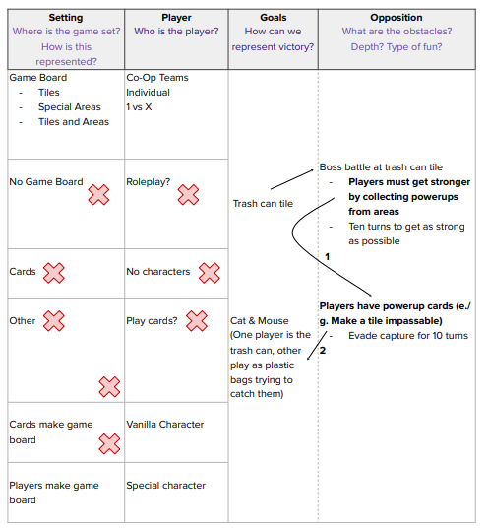
Idea “Spiraling”
Notes:
In the diagram, the idea of players gaining “power ups” spawned the idea of all players having powerups (represented by 1). This spawned the new “goal” category of the “trash can” being a playable character (represented by 2) that is on a different team to the plastic bags.
Asking the question “what if?” is very useful for this process. An example flow using “what if” is as follows: “What if you picked up power ups from around the city” > “What if everyone had power ups?” > “What if the trash can had power ups?” > “What if the trash can was a player?”

Slide 18
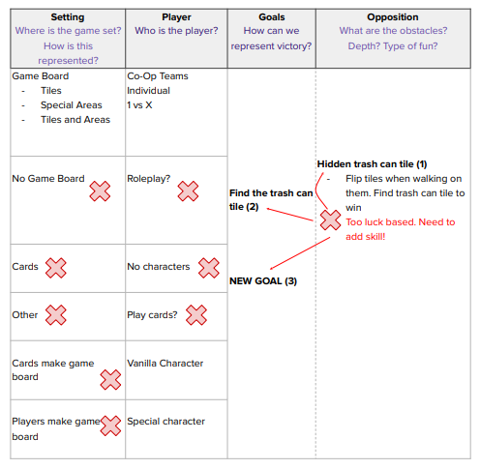
Backtracking
If students decided an iteration path didn’t work, they could backtrack either to point 1 or 2.
This is exemplified in the diagram side.
There might be an alternative branch off of path 1 that can work!
If they have exhausted options branching off of point 1, they might need to backtrack and branch off of point 2, or could even start fresh with a new goal (point 3). If all of these options are exhausted, it might be time to re-evaluate the player or setting (or even the premise!).

Slide 19
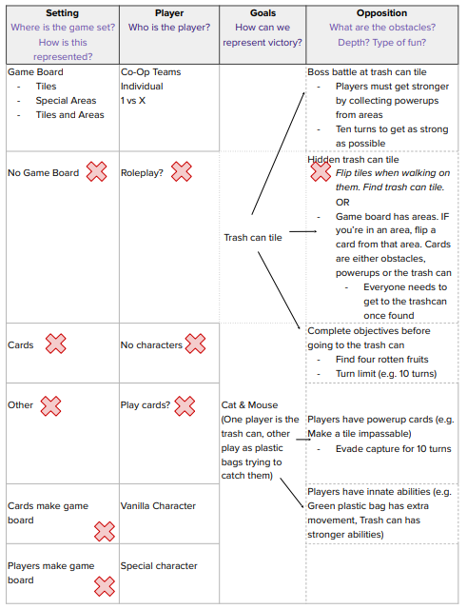
Final Example Game Idea

